Slide 1
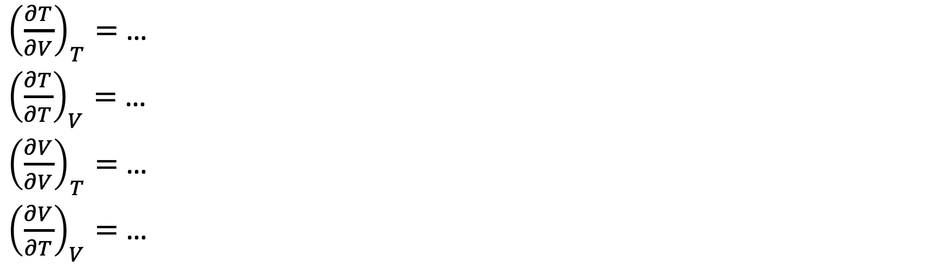
The “no-brainers” (we’ll figure out the values of these in a few minutes)
${\left(\frac{∂T}{∂V}\right)}_{T}=$ …
${\left(\frac{∂T}{∂T}\right)}_{V}=$ …
${\left(\frac{∂V}{∂V}\right)}_{T}=$ …
${\left(\frac{∂V}{∂T}\right)}_{V}=$ …

Slide 2
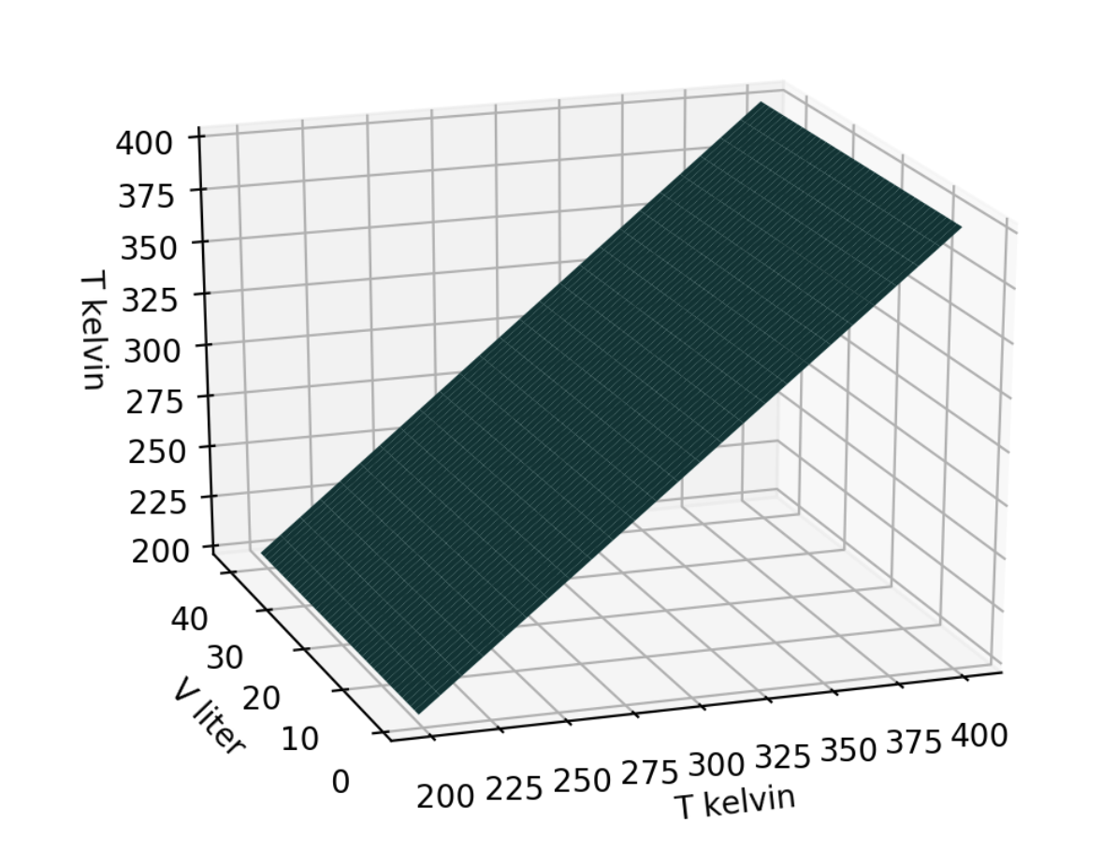
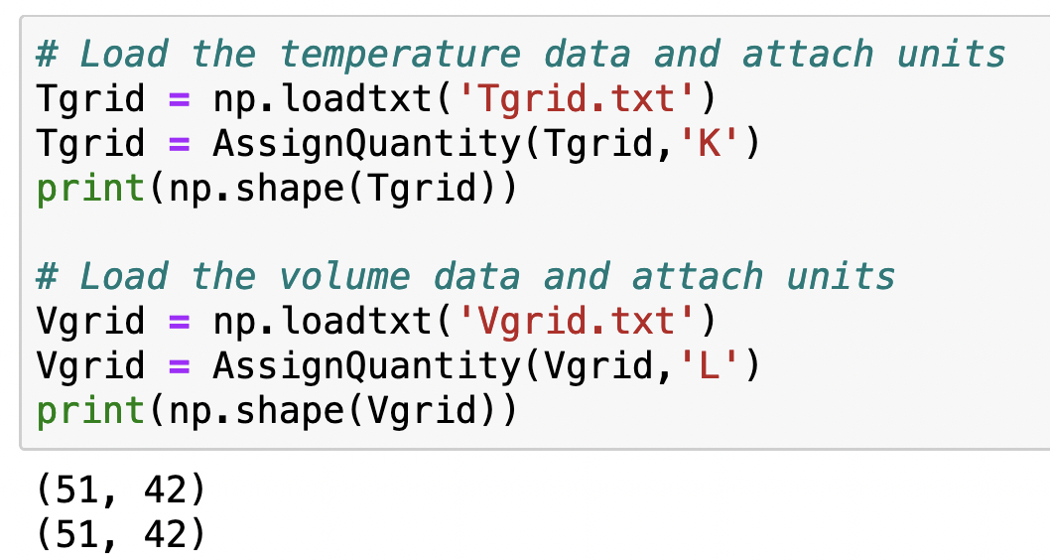
Tgrid: representation of the temperature part of state space

Slide 3
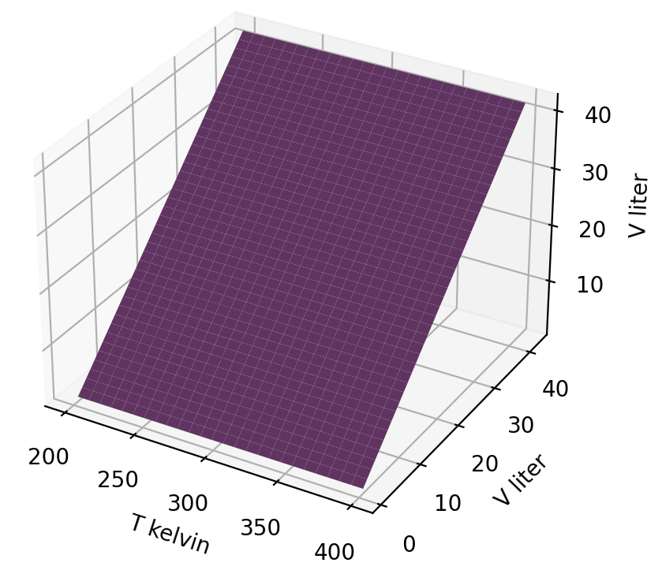
Vgrid: representation of the volume part of state space

Slide 4
Each grid has the same shape (51x42)

Slide 5
Indices in the grids allow us to refer to specific elements (scalars)
2nd index is the volume index
1st index is the temperature index

Slide 6

Isochores of Tgrid
$$T\left(T,V\right)$$
Elements of Tgrid that have different temperature indices have different temperatures:
Tgrid[0,0] = 200
Tgrid[1,0] = 204 (etc.)
All the elements of Tgrid belonging to a certain volume index is an array:
Tgrid[:,0] = 200, 204, … 400

Slide 7
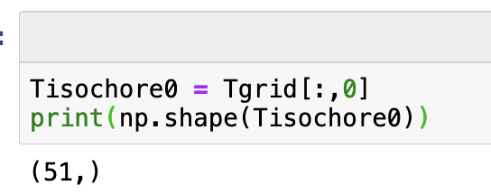

Isochores of Tgrid
$$T\left(T,V\right)$$
Elements of Tgrid that have different temperature indices have different temperatures:
Tgrid[0,0] = 200
Tgrid[1,0] = 204 (etc.)
All the elements of Tgrid belonging to a certain volume index is an array:
Tgrid[:,0] = 200, 204, … 400
Here’s how you’d create a variable that is this array. Notice that it has 51 elements, whose values run from 200 to 400 K.

Slide 8
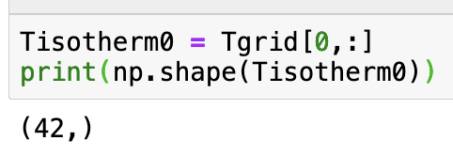
Isotherms of Tgrid
$$T\left(T,V\right)$$
All the elements of Tgrid belonging to the first temperature index is the (very boring) array
Tgrid[0,:] = 200, 200, 200, …
All the elements of Tgrid belonging to the second temperature is also a very boring array
Tgrid[1,:] = 204, 204, 204, …
Here’s how you’d create such an array. It contains 42 elements, all the same number (200 K).

Slide 9
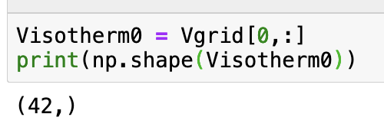

Isotherms of Vgrid
$$V(T,V)$$
Elements of Vgrid that have different volume indices have different volumes :
Vgrid[0,0] = 1 Liter
Vgrid[0,1] = 2 Liters (etc.)
All the elements of Vgrid belonging to a certain temperature index is an array:
Vgrid[0,:] = 1, 2, …
Here’s how you’d create a variable that is this array. Notice that it has 42 elements, whose values run from 1 to 42 Liters.

Slide 10
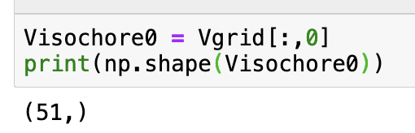

Isochores of Vgrid
$$V(T,V)$$
Elements of Vgrid that have different temperature indices all have the same volume:
Vgrid[0,0] = 1 Liter
Vgrid[1,0] = 1 Liter (etc.)
All the elements of Vgrid belonging to a certain volume index is a (very boring) array:
Vgrid[:,0] = 1, 1, …
Here’s how you’d create such an array. Notice that it has 51 elements, all the same number (1 Liter)

Slide 11

Back to the “no-brainers”
${\left(\frac{∂T}{∂V}\right)}_{T}=$ 0
${\left(\frac{∂T}{∂T}\right)}_{V}=$ 1
${\left(\frac{∂V}{∂V}\right)}_{T}=$ 1
${\left(\frac{∂V}{∂T}\right)}_{V}=$ 0

Slide 12
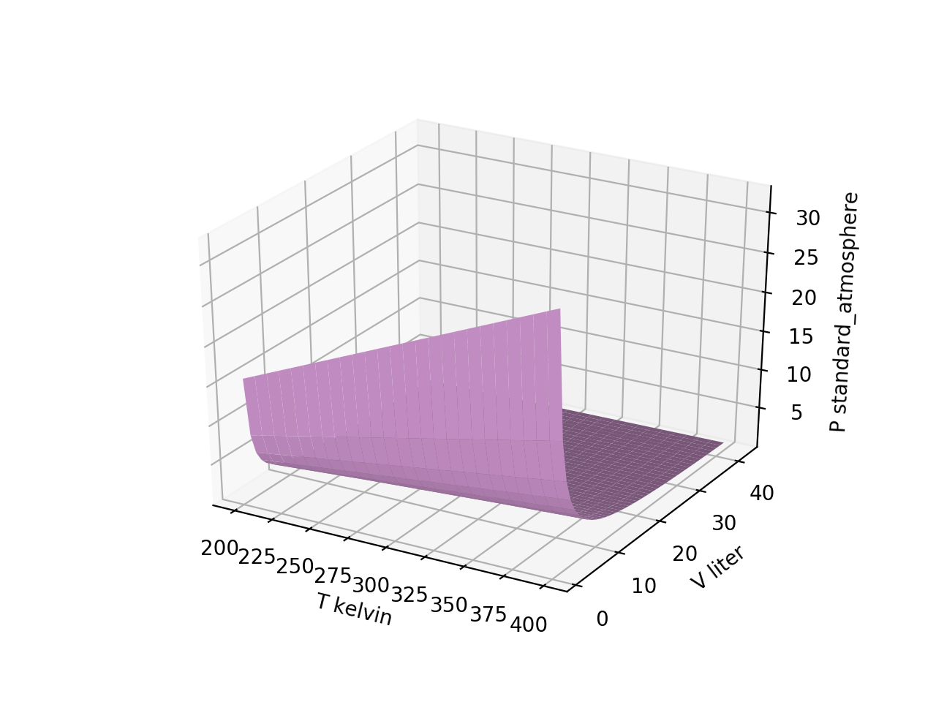
Isotherms of $P(T,V)$ (“Boyle isotherms”)

Slide 13
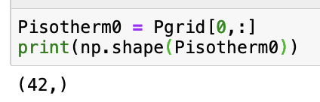
Isotherms of $P(T,V)$ (“Boyle isotherms”)

Slide 14

Isotherms of $P(T,V)$ (“Boyle isotherms”)

Slide 15
Isotherms of $P(T,V)$ (“Boyle isotherms”)
(Notice that Python lets you specify the last row as index “-1”)

Slide 16
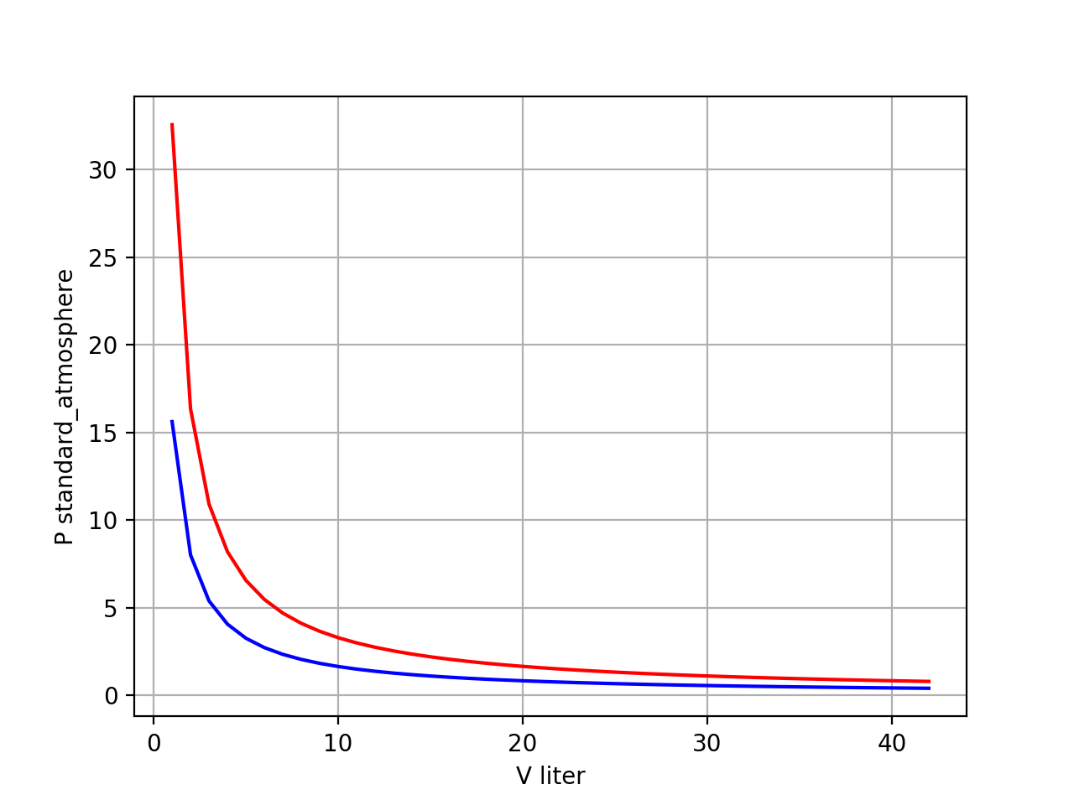
Isotherms of $P(T,V)$ (“Boyle isotherms”)
isotherms

Slide 17
Isotherms of $P(T,V)$ (“Boyle isotherms”)
T = 400 K isotherm
T = 200 K isotherm

Slide 18
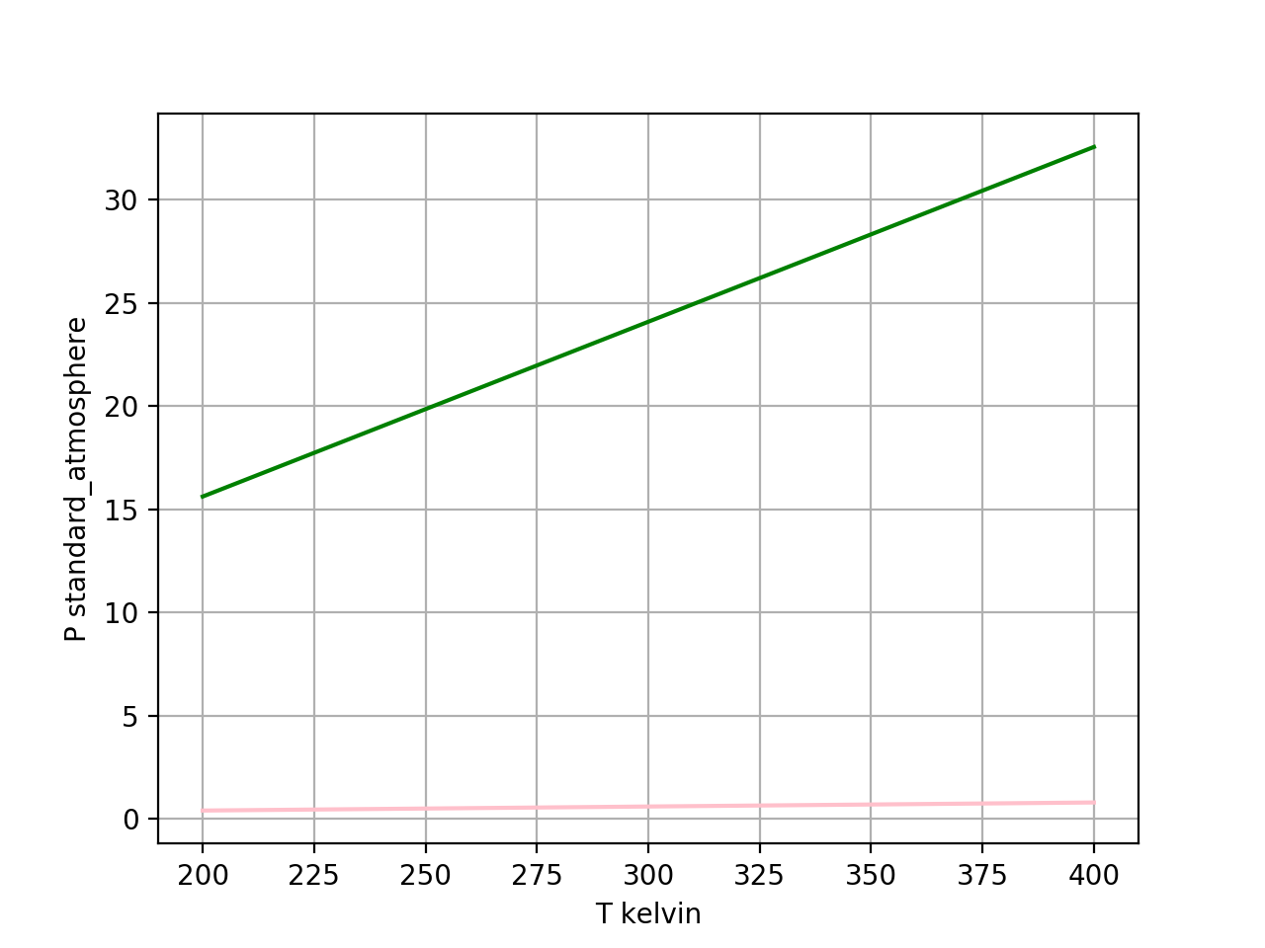
Isochores of $P(T,V)$
isochores

Slide 19
Isochores of $P(T,V)$
isochores

Slide 20
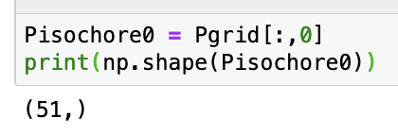
Isochores of $P(T,V)$
isochores

Slide 21
Isochores of $P(T,V)$
isochores

Slide 22
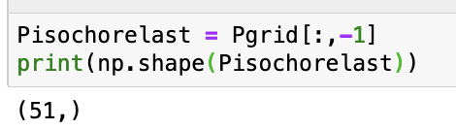
Isochores of $P(T,V)$
isochores

Slide 23
Isochores of $P(T,V)$
V = 1-Liter isochore
V = 42-Liter isochore

Slide 24


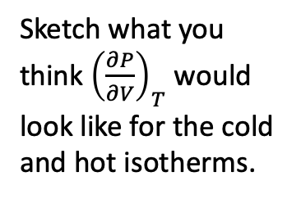
Numerical derivatives of Boyle isotherms
$P(V)$
Sketch what you think ${\left(\frac{∂P}{∂V}\right)}_{T}$ would look like for the cold and hot isotherms.
$${\left(\frac{∂P}{∂V}\right)}_{T}$$

Slide 25
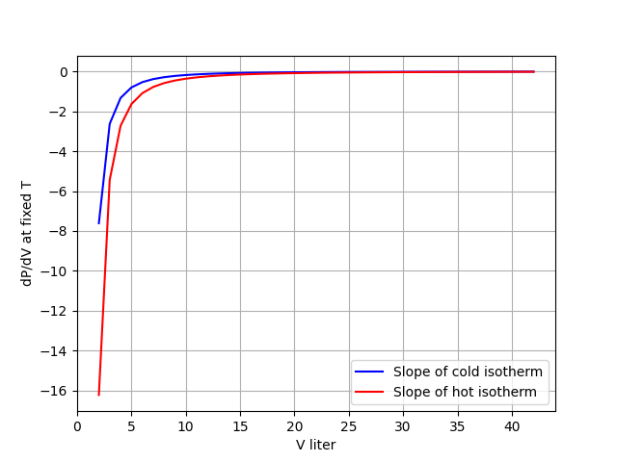
Numerical derivatives of Boyle isotherms
$P(V)$
$${\left(\frac{∂P}{∂V}\right)}_{T}$$

Slide 26
